Slide 1
Dr. SNS RAJALAKSHMI COLLEGE OF ARTS & SCIENCE (Autonomous)
Coimbatore -641049
Accredited by NAAC(Cycle–III) with ‘A+’ Grade
(Recognized by UGC, Approved by AICTE, New Delhi and
Affiliated to Bharathiar University, Coimbatore)
DEPARTMENT OF COMPUTER SCIENCE (GRAPHICS AND CREATIVE DESIGN)
COURSE NAME : INTRODUCTION TO COMPUTER ANIMATION
II YEAR /III SEMESTER
Unit I- Principles and Processes: Ideas Generation

Slide 2
Principles and Processes: Ideas Generation
Principles:
Divergent Thinking: Encourage open-mindedness and exploration of various possibilities without judgment. This allows for the generation of a wide range of ideas.
Quantity Over Quality: Aim for a large quantity of ideas initially. More ideas provide a broader pool to select from and often lead to more innovative solutions.
Processes:
Brainstorming: This is a classic technique where a group generates ideas in a free-flowing manner without criticism. It encourages participants to build on each other's ideas.
Mind Mapping: Start with a central concept and branch out with related ideas. This visual technique helps in exploring connections and generating new concepts.
Notes:
In this presentation, we will explore the principles and processes of idea generation. We will discuss different techniques for generating ideas, as well as how to create an environment that is conducive to creativity. By the end of this presentation, you will be able to generate more and better ideas.

Slide 3
What is Idea Generation?
Idea generation is the process of creating new ideas.
It is an essential part of innovation and problem-solving.
There are many different techniques for idea generation, both individual and group-based.
Notes:
Idea generation is the first step in the innovation process. It is the process of coming up with new ideas. Idea generation is essential for businesses that want to stay ahead of the competition. There are many different techniques for idea generation, so you can find one that works best for you.

Slide 4
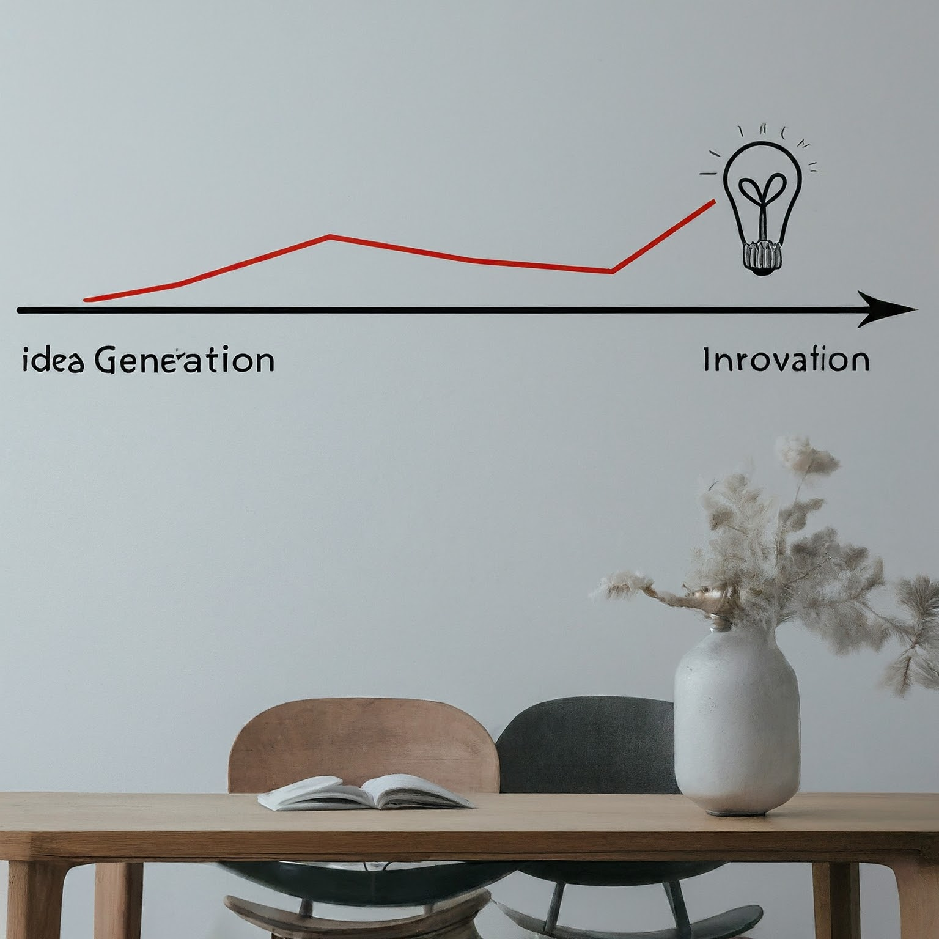
The Importance of Idea Generation
Idea generation is important for a number of reasons.
It helps businesses to stay ahead of the competition.
It can lead to new products, services, and processes.
It can help businesses to solve problems more effectively.
Notes:
Idea generation is essential for businesses that want to stay ahead of the competition. By generating new ideas, businesses can create new products and services that appeal to customers. Idea generation can also lead to new processes that can help businesses to operate more efficiently.

Slide 5
Principles of Idea Generation
There are a number of principles that can help you to generate more and better ideas.
Focus on quantity. The more ideas you generate, the more likely you are to come up with a good one.
Defer judgment. Don't censor your ideas at the beginning of the brainstorming process.
Build on the ideas of others. When someone comes up with an idea, try to improve on it or combine it with other ideas.
Think outside the box. Don't be afraid to come up with new and unusual ideas.
Notes:
There are a number of principles that can help you to generate more and better ideas. The first principle is to focus on quantity. The more ideas you generate, the more likely you are to come up with a good one. Second, defer judgment. Don't censor your ideas at the beginning of the brainstorming process. Third, build on the ideas of others. When someone comes up with an idea, try to improve on it or combine it with other ideas. Fourth, think outside the box. Don't be afraid to come up with new and unusual ideas.

Slide 6
Processes of Idea Generation
There are many different processes for idea generation.
Some popular processes include:
Brainstorming: A group technique for generating a large number of ideas in a short period of time.
Mind mapping: A visual technique for organizing ideas around a central topic.
SCAMPER: A technique for coming up with new ideas by asking a series of questions about an existing product or service.
Notes:
There are many different processes for idea generation. Some popular processes include brainstorming, mind mapping, and SCAMPER. Brainstorming is a group technique for generating a large number of ideas in a short period of time. Mind mapping is a visual technique for organizing ideas around a central topic. SCAMPER is a technique for coming up with new ideas by asking a series of questions about an existing product or service.

Slide 7
Brainstorming
Brainstorming is a popular technique for idea generation.
It is a group technique that can be used to generate a large number of ideas in a short period of time.
To brainstorm effectively, follow these steps:
Define the problem or challenge.
Set ground rules, such as:
Defer judgment.
Focus on quantity.
Build on the ideas of others.
Generate ideas.
Evaluate and select ideas.
Notes:
Brainstorming is a great way to come up with a lot of ideas in a short amount of time. It is a good technique to use when you are in the early stages of idea generation and are looking for a broad range of ideas. Here are some steps to follow for effective brainstorming: Define the problem or challenge that you are trying to solve. Set ground rules for the brainstorming session, such as deferring judgment, focusing on quantity, and building on the ideas of others. Generate as many ideas as possible. Don't censor yourself or worry about whether or not an idea is good. After you have generated a large number of ideas, evaluate and select the most promising ones.

Slide 8
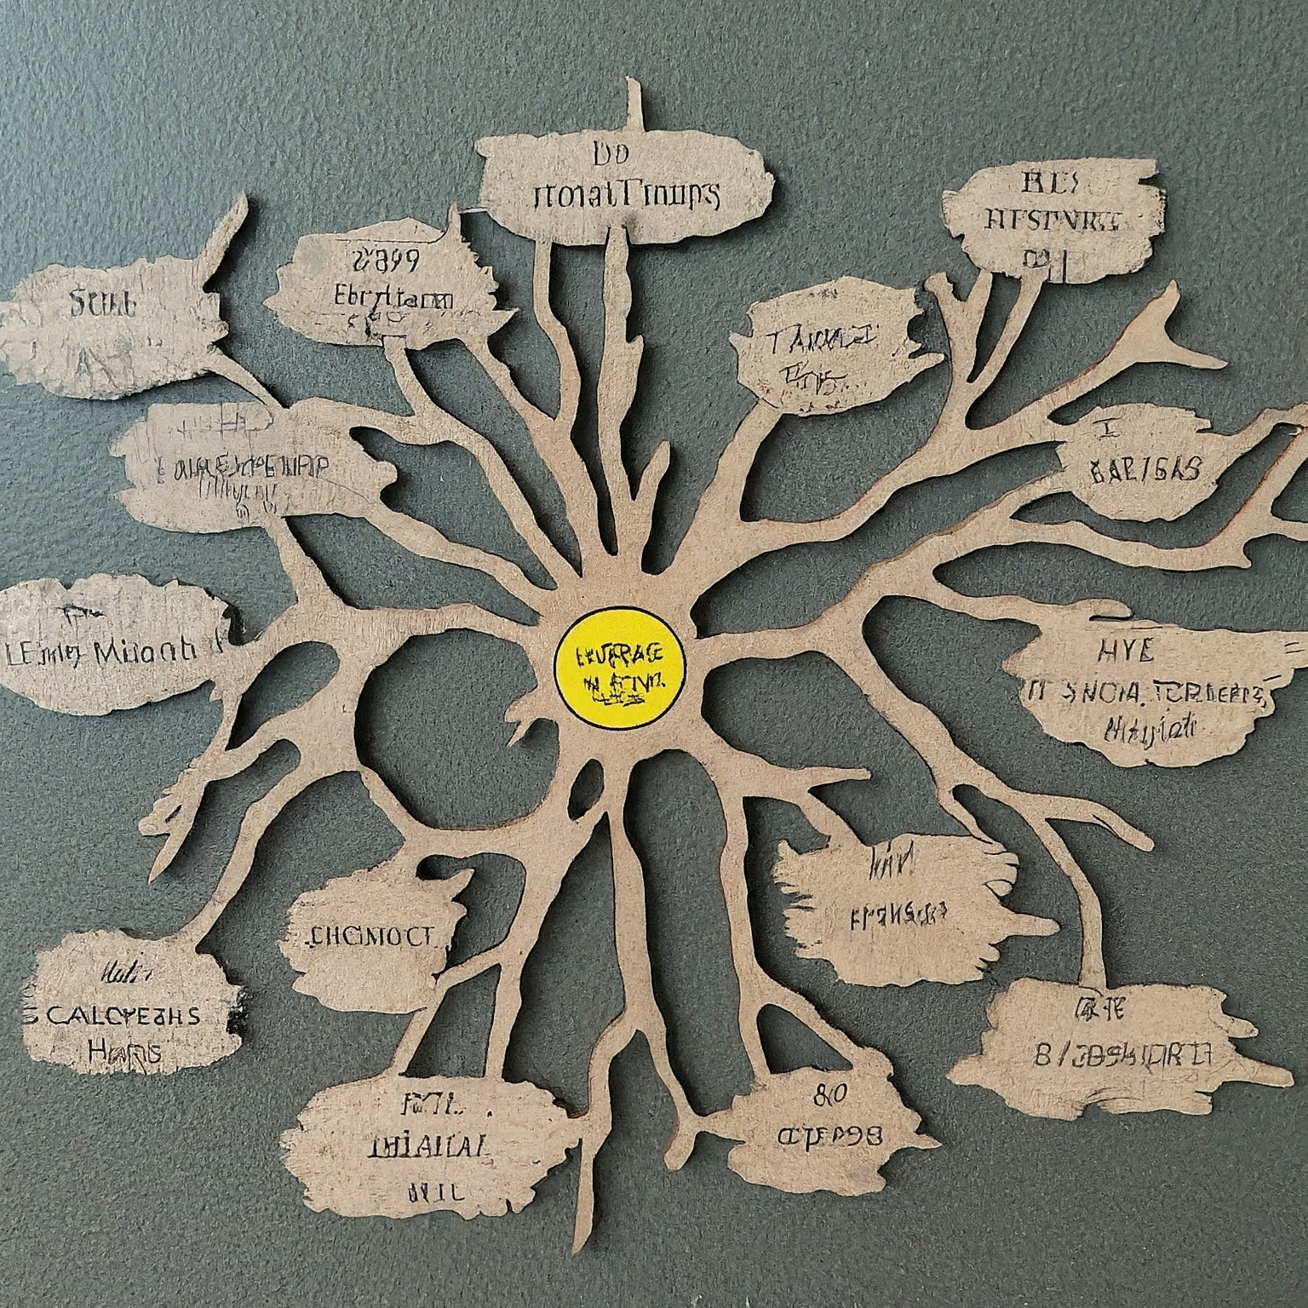
Mind Mapping
Mind mapping is a visual technique for organizing ideas around a central topic.
It is a non-linear way of brainstorming that can help you to see connections between ideas that you might not have seen otherwise.
To mind map, follow these steps:
Write down the central topic in the center of a piece of paper or whiteboard.
Draw branches radiating out from the central topic for each main idea.
Add sub-branches to the main branches for sub-ideas.
You can also add images, symbols, and colors to your mind map to make it more visually appealing.
Notes:
Mind mapping is a great way to visually organize your ideas. It is a good technique to use when you are trying to see the big picture and how different ideas are related. Here are some steps to follow for mind mapping: Write down the central topic in the center of a piece of paper or whiteboard. Draw branches radiating out from the central topic for each main idea. Add sub-branches to the main branches for sub-ideas. You can also add images, symbols, and colors to your mind map to make it more visually appealing. Mind mapping can be done individually or in a group.

Slide 9
SCAMPER
SCAMPER is a technique for coming up with new ideas by asking a series of questions about an existing product or service.
The letters in SCAMPER stand for:
Substitute: What can be substituted?
Combine: What can be combined?
Adapt: What can be adapted?
Modify: What can be modified?
Put to other uses: What can be put to other uses?
Eliminate: What can be eliminated?
Rearrange: What can be rearranged?
Notes:
SCAMPER is a great way to come up with new ideas by looking at an existing product or service in a new light. By asking the questions in the SCAMPER acronym, you can come up with a surprising number of new ideas. For example, if you are trying to come up with new ideas for a pen, you could ask yourself: What if we substituted the ink with a different material? What if we combined a pen with a highlighter? What if we adapted a pen to be used by people with disabilities? SCAMPER is a versatile technique that can be used to generate new ideas for any product, service, or process.

Slide 10
Creating an Environment Conducive to Creativity
There are a number of things you can do to create an environment that is conducive to creativity.
Some tips include:
Encourage playfulness and experimentation.
Provide access to resources and materials.
Foster collaboration and teamwork.
Reduce stress and anxiety.
Celebrate creativity and innovation.
Notes:
The environment you work in can have a big impact on your creativity. If you want to generate more and better ideas, you need to create an environment that is conducive to creativity. Here are some tips: Encourage playfulness and experimentation. Don't be afraid to try new things and take risks. Provide access to resources and materials. The more resources you have at your disposal, the more creative you can be. Foster collaboration and teamwork. Creativity is often sparked by interaction with others. Reduce stress and anxiety. When you are stressed or anxious, it is difficult to be creative. Celebrate creativity and innovation. Let people know that you value their creativity and new ideas.

Slide 11
Conclusion
Idea generation is an essential skill for anyone who wants to be innovative.
By following the principles and processes discussed in this presentation, you can generate more and better ideas.
So get out there and start brainstorming!
Notes:
In this presentation, we have discussed the principles and processes of idea generation. We have talked about the importance of idea generation, the principles of idea generation, and the processes of idea generation. We have also discussed how to create an environment that is conducive to creativity. By following the tips in this presentation, you can generate more and better ideas. So get out there and start brainstorming! Remember, the key to idea generation is to be open-minded, think outside the box, and don't be afraid to try new things.

Slide 12
Thank You

